Slide 1
Chapter 3
Brief Overview of XML
Mike P. Papazoglou &
mikep@uvt.nl

Slide 2
Topics
XML document structure
XML schemas reuse
Document navigation and transformation

Slide 3
Markup
A method of distinguishing text from instructions in typesetting systems.
Markup = instructions to computerized
typesetting systems.
Special characters are used to show where a markup
instruction starts and stops.
Example:
<centre on> This is a <italics on> very serious <italics off> matter.<centre off>
This is a very serious matter.
“Tags” are easily understandable by both the human reader and the machine.

Slide 4
XML
Extensible Markup Language (XML) is not a set of tags itself but a meta-language that allows you to create and use tag sets in a standard way.
Provides fixed rules about markup structures (elements, attributes, and entities), about their notation, and their function.

Slide 5
Book Catalog in XML
<BOOK>
<TITLE>
Web Services: Principles and Technology
</TITLE>
<AUTHOR>
Mike P. Papazoglou
</AUTHOR>
<DATE> 2007 </DATE>
<PUBLISHER>
Prentice Hall
</PUBLISHER>
</BOOK>
This document has XML tags.
A human and a computer can now easily
extract the publisher data.

Slide 6
XML structure
Document type: XML documents are regarded as having types.
  XML’s constituent parts and their structure formally define the type of a document.
An XML document is composed of named containers and their contained data values.
  containers are represented as declarations, elements, and attributes.
An XML document is also known as an instance or XML document instance to signify that it represents one possible set of data for a particular markup language.
<?xml version="1.0" encoding="UTF-8"?>
<BillingInformation>
<Name> Right Plastic Products </Name>
<BillingDate> 2002-09-15 </BillingDate>
<Address>
<Street> 158 Edward st. </Street>
<City> Brisbane </City>
<State> QLD </State>
<PostalCode> 4000 </PostalCode>
</Address>
</BillingInformation>
Example of an XML document instance.

Slide 7
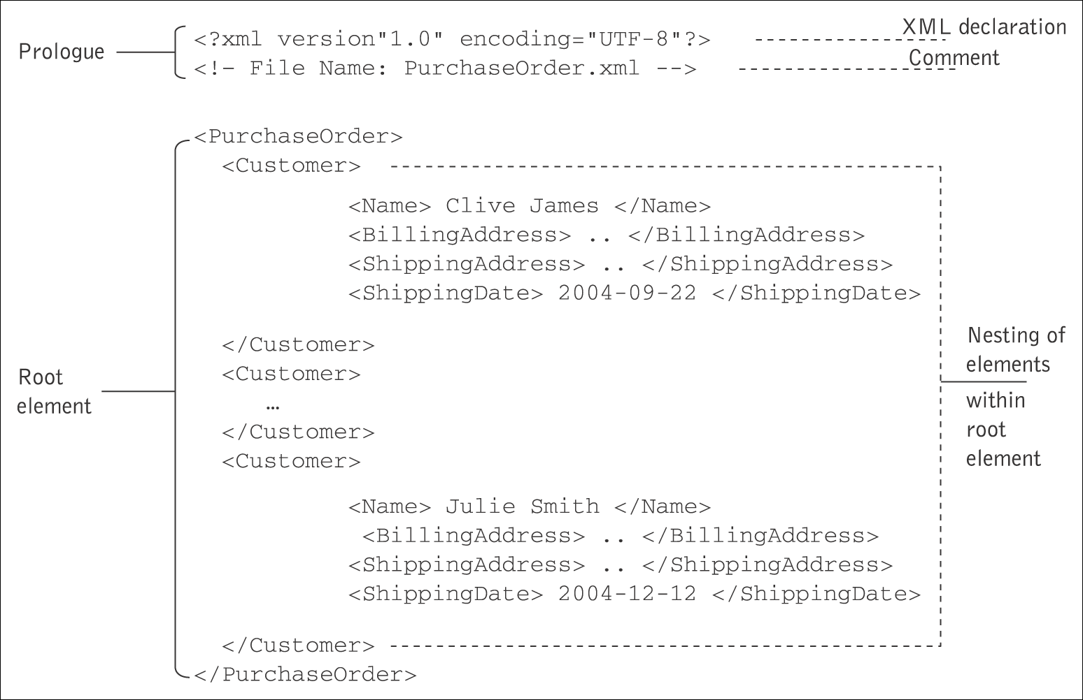
Layout of a typical XML document
Layout of a typical XML document
Notes:
Root Element = Presentation
Element Content = Speaker
Data Content = Name and Company information
Title – Data content (only contains data)

Slide 8
XML: Elements
Elements are fundamental units of content comprising element name and element content.
  An element is a sequence of characters that begins with a start tag and ends with an end tag and includes everything in between.
<chapter number="1">
Text for Chapter 1
</chapter>
What is content?
The characters in between the tags (rendered in green in this presentation) constitute the content.
The topmost element of the XML document is a single element known as the root element.
Elements contained in other elements are referred to as nested elements.
  The containing element is the parent element and the nested element is called the child element.

Slide 9
XML: Attributes
Another way of putting data into an XML document is by adding attributes to start tags.
  An attribute specification is a name–value pair that is associated with an element.
  Attributes are used to better specify the content of an element on which they appear by adding information about a defined element.
<?xml version=”1.0” encoding=”UTF-8”?>
<BillingInformation customer-type=”manufacturer”>
<Name> Right Plastic Products </Name>
<BillingDate> 2002-09-15 </BillingDate>
<Address>
<Street> 158 Edward st. </Street>
<City> Brisbane </City>
<State> QLD </State>
<PostalCode> 4000 </PostalCode>
</Address>
</BillingInformation>

Slide 10
XML Namespaces
Namespaces in XML provide a facility for associating the elements and/or attributes in all or part of a document with a particular schema and avoiding name clashes.
Namespace declarations have a scope.
  A namespace declaration is in scope for the element on which it is declared and of that element’s children.
The namespace name and the local name of the element together form a globally unique name known as a qualified name.
<?xml version=”1.0” encoding=”UTF-8”?>
<BillingInformation customer-type=”manufacturer”
xmlns="http://www.plastics_supply.com/BillInfo">
<Name> Right Plastic Products </Name>
<Address xmlns="http://www.plastics_supply.com/Addr">
<Street> 158 Edward st. </Street>
<City> Brisbane </City>
<State> QLD </State>
<PostalCode> 4000 </PostalCode>
</Address>
<BillingDate> 2002-09-15 </BillingDate>
</BillingInformation>
Uniform resource identifier (URI).

Slide 11
XML: structure
Linear sequence
An XML document must have a root tag.
An XML document is an information unit that can be seen in two ways:
  As a linear sequence of characters that contain characters data and markup.
  As an abstract data structure that is a tree of nodes.
  <book>
  <chapter n=“1”> Title 1 </chapter>
  <section n=“1.1”> Section 1.1 </section>
  <paragraph> …. <paragraph>
  <section n=“1.2”> Section 1.2 </section>
  <chapter n=“2”> Title 2 </chapter>
  <section n=“2.1”> Section 2.1 </section>
  < paragraph > …. < paragraph >
  </book>
Tree
Book
Chapter
Chapter
Section
Section
Section
Para
Para

Slide 12
XML Schema
XML schema refers to a document that defines the content of and structure for expressing XML documents.
Schemas provide support for additional meta-data characteristics such as structural relationships, cardinality, valid values, and data types.
Each type of schema acts as a method of describing data characteristics and applying rules and constraints to a referencing XML document.
An XML schema describes the elements and attributes that may be contained in a schema conforming document and the ways that the elements may be arranged within a document structure.
Notes:
DTD Drawbacks: can’t define constraints,

Slide 13
XML schema and instance document
File “Person.xml” File “Person.xsd”
<?xml version="1.0" encoding="UTF-8"?>
<Person xmlns:xsi="http://www.w3.org/
2001/XMLSchema-instance" xsi:noNamespaceSchemaLocation="Person.xsd">
<First>Sophie</First>
<Last>Jones</Last>
<Age>34</Age>
</Person>
<?xml version="1.0" encoding="UTF-8"?>
<xs:schema
xmlns:xs="http://www.w3.org/2001/
XMLSchema">
<xs:element name="Person">
<xs:complexType>
<xs:sequence>
<xs:element name="First“
type="xs:string"/>
<xs:element name="Middle“
type="xs:string“
minOccurs="0"/>
<xs:element name="Last“
type="xs:string"/>
<xs:element name="Age“
type="xs:integer"/>
</xs:sequence>
</xs:complexType>
</xs:element>
</xs:schema>

Slide 14
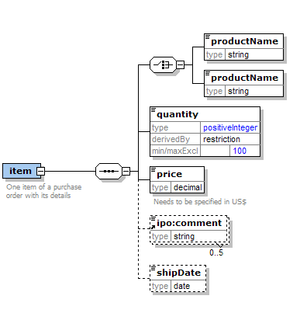
Schema Components
Elements and their content model
<element name="item">
<annotation>
<documentation>One item of a purchase order with its
details</documentation>
</annotation>
<complexType>
<sequence>
<choice>
<element name="productName" type="string"/>
<element name="productName" type="string"/>
</choice>
<element name="quantity">
<simpleType>
<restriction base="positiveInteger">
<maxExclusive value="100"/>
</restriction>
</simpleType>
</element>
<element name="price" type="decimal">
<annotation>
<documentation>Needs to be specified in
US$</documentation>
</annotation>
</element>
<element ref="ipo:comment" minOccurs="0" maxOccurs="5"/>
<element name="shipDate" type="date" minOccurs="0"/>
</sequence>
<attribute name="partNum" type="ipo:Sku"/>
</complexType>
</element>

Slide 15
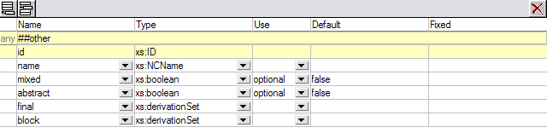
Schema Components (continued)
Attributes and Attribute Groups
<xs:attribute name="name" type="xs:NCName"/>
<xs:attribute name="mixed" type="xs:boolean" use="optional" default="false"/>
<xs:attribute name="abstract" type="xs:boolean" use="optional" default="false"/>
<xs:attribute name="final" type="xs:derivationSet"/>
<xs:attribute name="block" type="xs:derivationSet"/>

Slide 16
Schema Components (continued)
Complex Types
<xsd:complexType name="PersonType">
<xsd:sequence>
<xsd:element name="First" type="xsd:string"/>
<xsd:element name="Last" type="xsd:string"/>
<xsd:element name="Title" type="xsd:string“
minOccurs="0"/>
<xsd:element name="PhoneExt" type="xsd:int"/>
<xsd:element ref="EMail"/>
</xsd:sequence>
</xsd:complexType>
<xsd:element name="Person" type="PersonType"/>
<xsd:element name="VIP“
substitutionGroup="Person">
<xsd:complexType>
<xsd:complexContent>
<xsd:extension base="PersonType">
<xsd:attribute name="IQ" type="xsd:int"/>
</xsd:extension>
</xsd:complexContent>
</xsd:complexType>
</xsd:element>

Slide 17
Topics
XML document structure
XML schemas reuse
Document navigation and transformation

Slide 18
Complex type extensions
<?xml version="1.0" encoding="UTF-8"?>
<xsd:schema
xmlns:xsd="http://www.w3.org/2001/XMLSchema"
xmlns:PO="http://www.plastics_supply.com/PurchaseOrder"
targetNamespace="http://www.plastics_supply.com/PurchaseOrder">
<xsd:complexType name="Address">
<xsd:sequence>
<xsd:element name="Number" type="xsd:decimal"/>
<xsd:element name="Street" type="xsd:string"/>
<xsd:element name="City" type="xsd:string" minOccurs="0"/>
</xsd:sequence>
</xsd:complexType>
<xsd:complexType name="AustralianAddress">
<xsd:complexContent>
<xsd:extension base="PO:Address">
<xsd:sequence>
<xsd:element name="State" type="xsd:string"/>
<xsd:element name="PostalCode" type="xsd:decimal"/>
<xsd:element name="Country" type="xsd:string"/>
</xsd:sequence>
</xsd:extension>
</xsd:complexContent>
</xsd:complexType>
</xsd:schema>

Slide 19
Complex type restrictions
<!-- Uses the data type declarations from Listing on page 17 -->
<xsd:complexType name="AustralianPostalAddress">
<xsd:complexContent>
<xsd:restriction base="PO:AustralianAddress">
<xsd:sequence>
<xsd:element name="Number" type="xsd:decimal"/>
<xsd:element name="Street" type="xsd:string"/>
<xsd:element name="City" type="xsd:string" minOccurs="0" maxOccurs="0"/>
<xsd:element name="State" type="xsd:string"/>
<xsd:element name="PostalCode" type="xsd:decimal"/>
<xsd:element name="Country" type="xsd:string"/>
</xsd:sequence>
</xsd:restriction>
</xsd:complexContent>
</xsd:complexType>

Slide 20
Complex type polymorphism
<!-- Uses the data type declarations from Listing on page 17 -->
<xsd:complexType name="PurchaseOrder">
<xsd:sequence>
<xsd:element name="Name" minOccurs="1" maxOccurs="1">
<xsd:simpleType>
<xsd:restriction base="xsd:string"/>
</xsd:simpleType>
</xsd:element>
<xsd:element name="shippingAddress" type="PO:Address" minOccurs= "1"
maxOccurs="1"/>
<xsd:element name="billingAddress" type="PO:Address" minOccurs= "1"
maxOccurs="1"/>
<xsd:choice minOccurs="1" maxOccurs="1">
<xsd:element name="BillingDate" type="xsd:date"/>
<xsd:element name="ShippingDate" type="xsd:date"/>
</xsd:choice>
</xsd:sequence>
</xsd:complexType
Variant of the PurchaseOrder type that uses
the base type Address for its billingAddress
and shippingAddress elements.

Slide 21
Complex type polymorphism (Continued)
<?xml version="1.0" encoding=”UTF-8”?>
<PO:PurchaseOrder xmlns:PO="http://www.plastics_supply.com/PurchaseOrder">
<Name> Plastic Products </Name>
<shippingAddress xsi:type="PO:AustralianAddress">
<Number> 459 </Number>
<Street> Wickham st. </Street>
<City> Fortitude Valley </City>
<State> QLD </State>
<PostalCode> 4006 </PostalCode>
<Country> Australia </country>
</shippingAddress>
<billingAddress xsi:type=="PO:AustralianAddress">
<Number> 158 </Number>
<Street> Edward st. </Street>
<State> QLD </State>
<PostalCode> 4000 </PostalCode>
<Country> Australia </Country>
</billingAddress>
<BillingDate> 2002-09-15 </BillingDate>
</PO:PurchaseOrder>
An instance document can now use any type derived from base type Address
for its billingAddress and
shippingAddress elements.
PurchaseOrder type uses the
derived AustralianAddress
type as its billingAddress and the derived
AustralianPostalAddress type as its
shippingAddress elements.

Slide 22
Topics
XML document structure
XML schemas reuse
Document navigation and transformation

Slide 23
Document Navigation and Transformation
XML is primarily used to describe and contain data. Although the most obvious and effective use of XML is to describe data, the eXtensible Stylesheet Language Transform (XSLT) can also be used to format or transform XML content for presentation to users.
The XSLT process transforms an XML structure into presentation technology such as HTML or into any other required forms and structures.
XSLT uses the XML Path Language or XPath to address and locate sections of XML documents.
XPath is a standard for creating expressions that can be used to find specific pieces of information within an XML document.
  XPath is an abstract language that defines a tree model that codifies the logical structure of an XML document against which all expressions are evaluated.

Slide 24
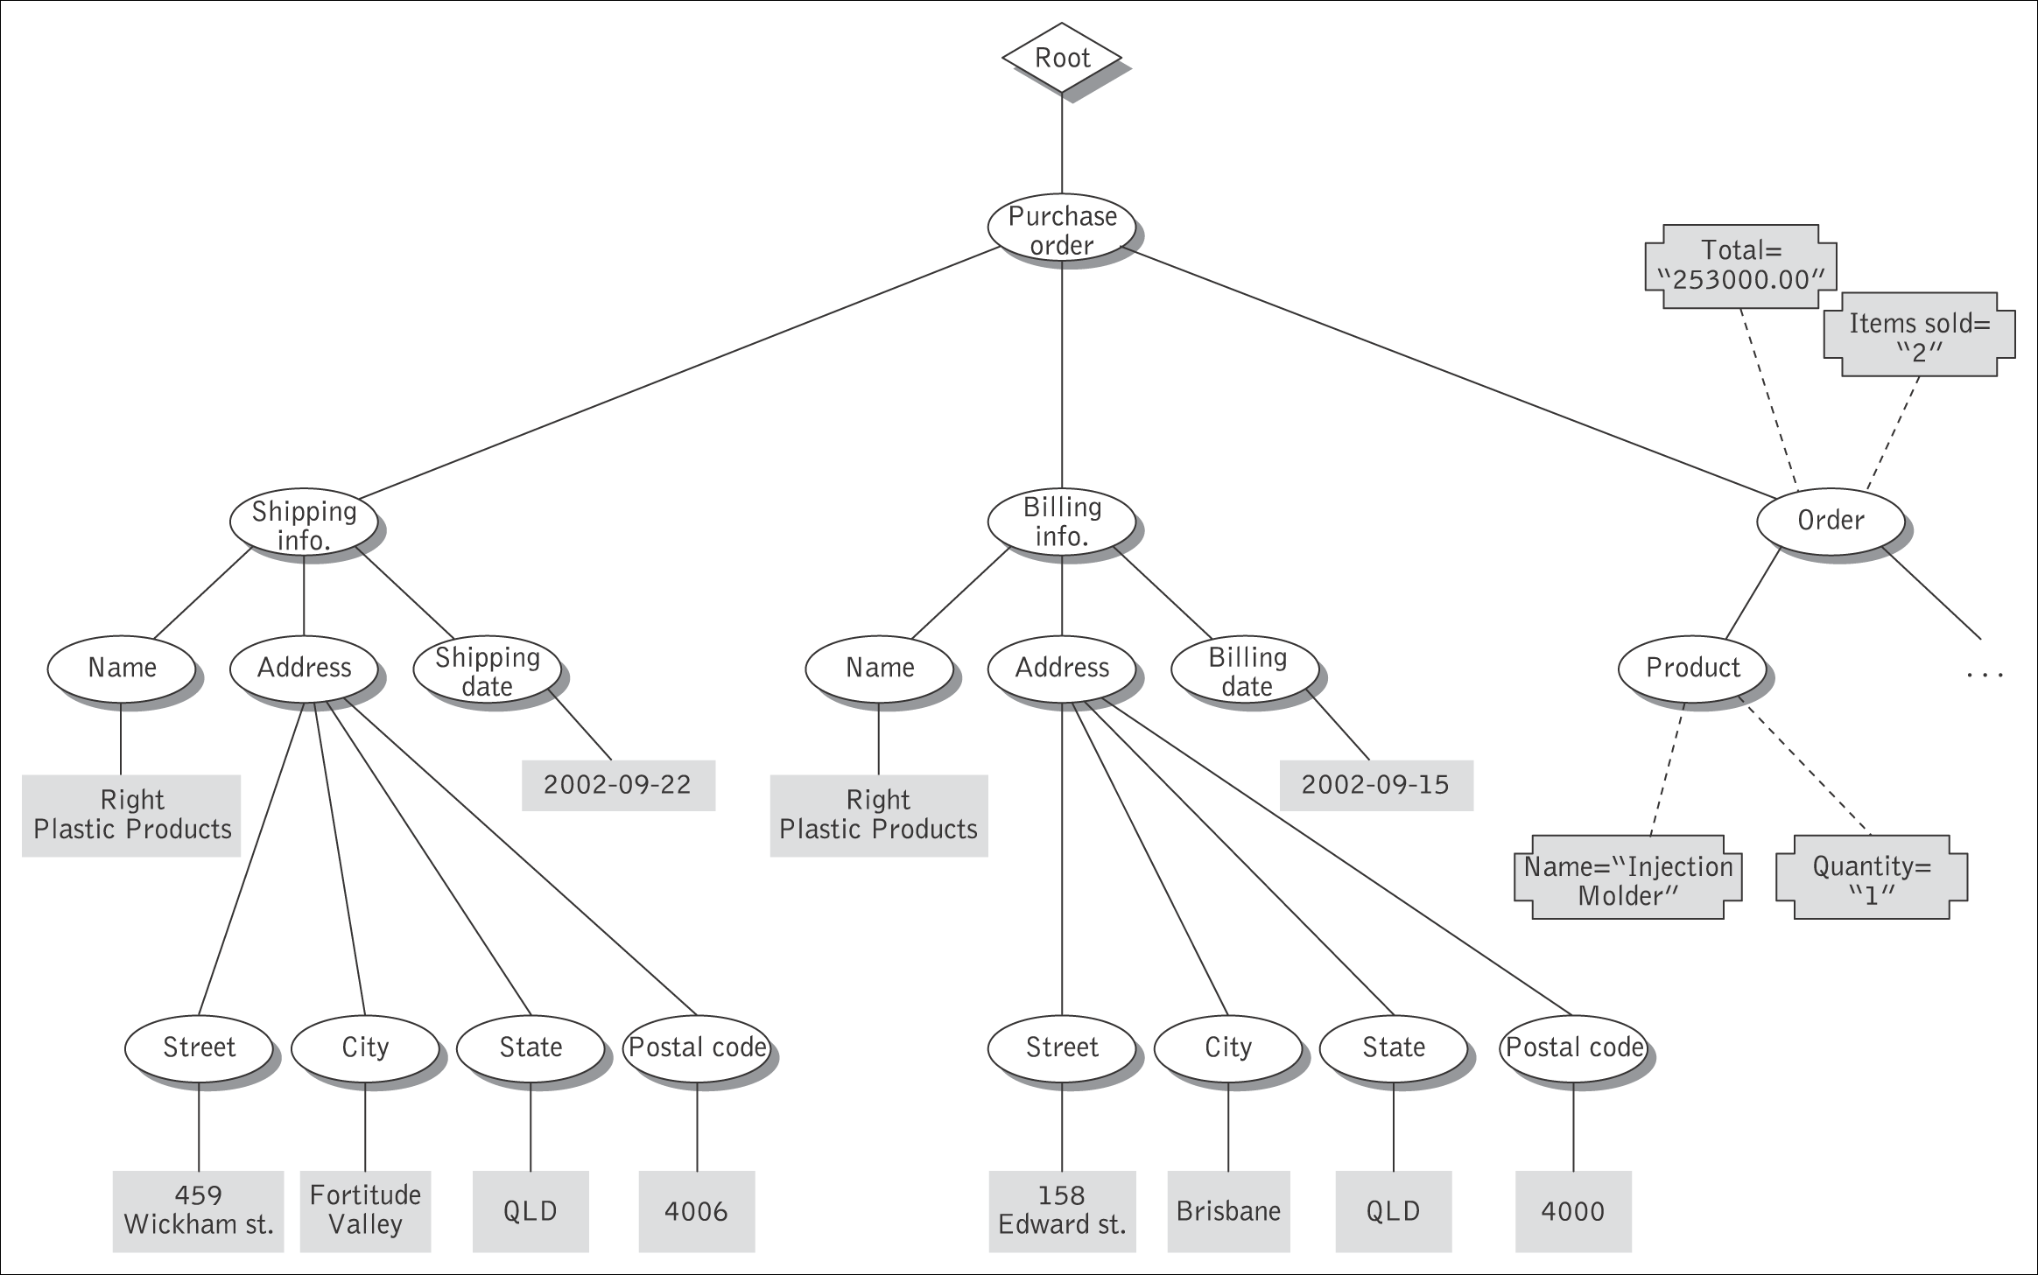
XPath tree model for instance document
XPath tree model for instance document

Slide 25
Example of document transformation
<PurchaseOrder>
<Name> Plastic Products </Name>
<billingAddress>
<Number> 158 </Number>
<Street> Edward st. </Street>
<State> QLD </State>
<PostalCode> 4000 </PostalCode>
<Country> Australia </country>
</billingAddress>
<PurchaseOrder>
Source
XML
application
Transformation service
<PurchaseOrder>
<Name> Plastic Products </Name>
<billingAddress>
<Number> 158 </Number>
<Street> Edward st. </Street>
<PostalCode> QLD 4000 </PostalCode>
<Country> Australia </country>
</billingAddress>
<PurchaseOrder>
Target
XML
application
Example of document transformation

